Slide 1
IOT in Crime Management

Slide 2
Team Moja
Ali Myataza
Wanga Mbabe
Yamkela Xaka
Ntando Mniki

Slide 3
01
02
Introduction
Research
03
04
Method
Implementation
05
06
Results
Discussion

Slide 4
Problem
Crime has proven to be a prevalent problem in South Africa, with vehicle related crimes not being any exception. According to the vehicle tracking company, Tracker, while South Africa experienced a significant drop in vehicle crime during the lockdown set in place due to the global pandemic, the criminal activity seems to have increased back to normal since restrictions have been relaxed. Crimes include carjacking, muggings, shootings, and theft of vehicles and of items inside vehicles, and these crimes happen frequently in particular areas of the country.

Slide 5
Proposed Solution
We propose an application that:
maps out a city’s most dangerous places, and warns a commuter when they are nearing those places.
allows a user to send an alert if they run into trouble.
City of interest is Cape Town

Slide 6
Related Projects
State-Of-the-Art
IoT in Smart Cities, Waze App, Crime Alert, Crime Agitator App, Citizen app
Feasibility
Technical:
We would have to take into consideration whether the resources are available to build this application (at a larger scale).
Man power- are there enough programmers, are there enough testers?
Economical:
Cost of building the application would have to be taken into consideration. Most crime alert apps are free and make money off of advertising or third-party data sharing.
Machine Learning in similar applications
Machine learning has been used in similar projects to classify the severity of accidents at particular places (Prakash et.al. 2019)
It has also been used to predict the likelihood of a crime to occur at a particular place, and the time it is likely to occur.
Research
Security and Ethics
Every project presents ethical concerns, and in the case of IoT applications, it would be the issue of whether or not people’s data is safe when they use the application.
For our application, the intention is to give users some control over the data they share, for example, when not in use – you can opt not to share your location.
Data will not be shared without permission.
Application asks for permissions to send notifications

Slide 7
Design & Methodology
Project Approach:
Focus on one city(for now) – Cape Town
Gather data about high crime locations
Design application that works with the Google Maps API to be able to pinpoint those dangerous areas, as well as a user’s location.
Allow for the sending of alert notifications from user (if in trouble) to other devices connected to the application, using Firebase Cloud Messages.

Slide 8
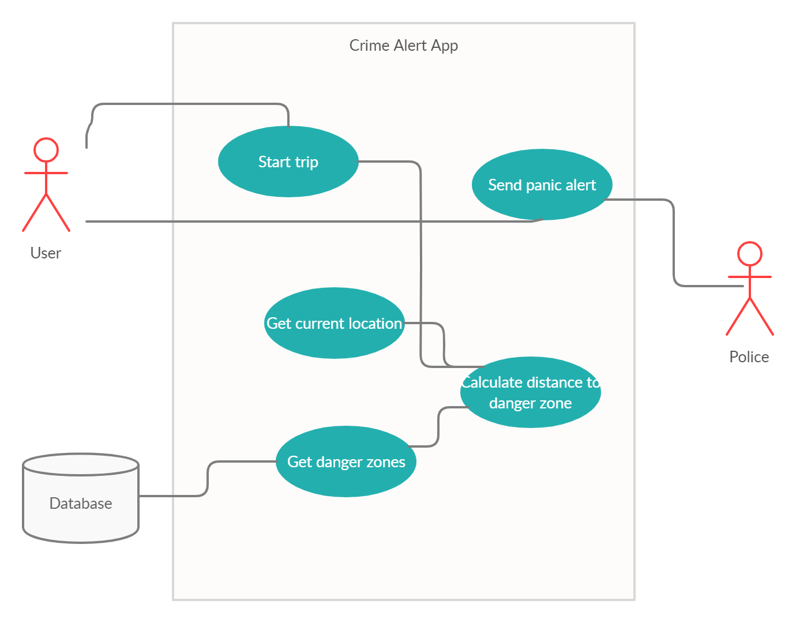
Use Case

Slide 9
Business Value and Process
Like most crime alert applications, an application of this kind would be free and so money would be made by the developers through advertising on the app.
However, in that case, we would have to take into account the ethics involved in that – and avoid selling user data to third party applications.
The application presents the possibility of decreasing fatalities as a result of crime, because if a notification is received as soon as the crime happens – help will be there quicker. Because the application warns a user of a danger zone, they can completely avoid that place altogether.

Slide 10
STRUCTURE
GPS Sensor on your mobile phone is used to pinpoint your location.
The devices are connected to each other through the same application. Should one device press the panic button, then that message is sent through to another device with the application, using Firebase Cloud Messages (FCM) over the internet.

Slide 11
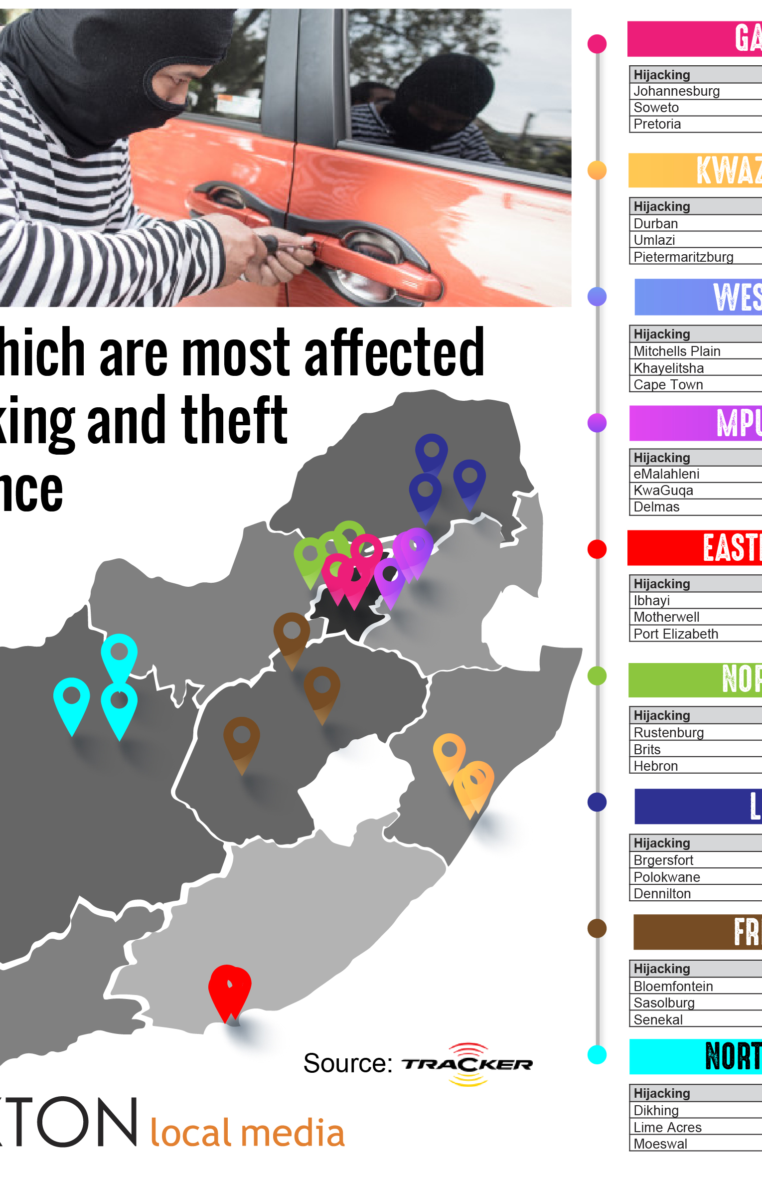
Implementation
TOOLS
Flutter
Google Maps API
Google Firebase

Slide 12
ARCHITECTURE
We stream data (locations) from Google Maps, using Google API and store the data on Google Firebase. The login registrations(emails, passwords) of the user also get stored on firebase, so that they are recognized when they login again.
The Google API is used to locate the user and the dangerous areas in Cape Town so that in the event that a user is attacked, they can press a button and their location is logged.
Upon pressing the button, the database is updated with the user’s location and then using FCM, other devices with the same application can be notified of the user’s danger.

Slide 13
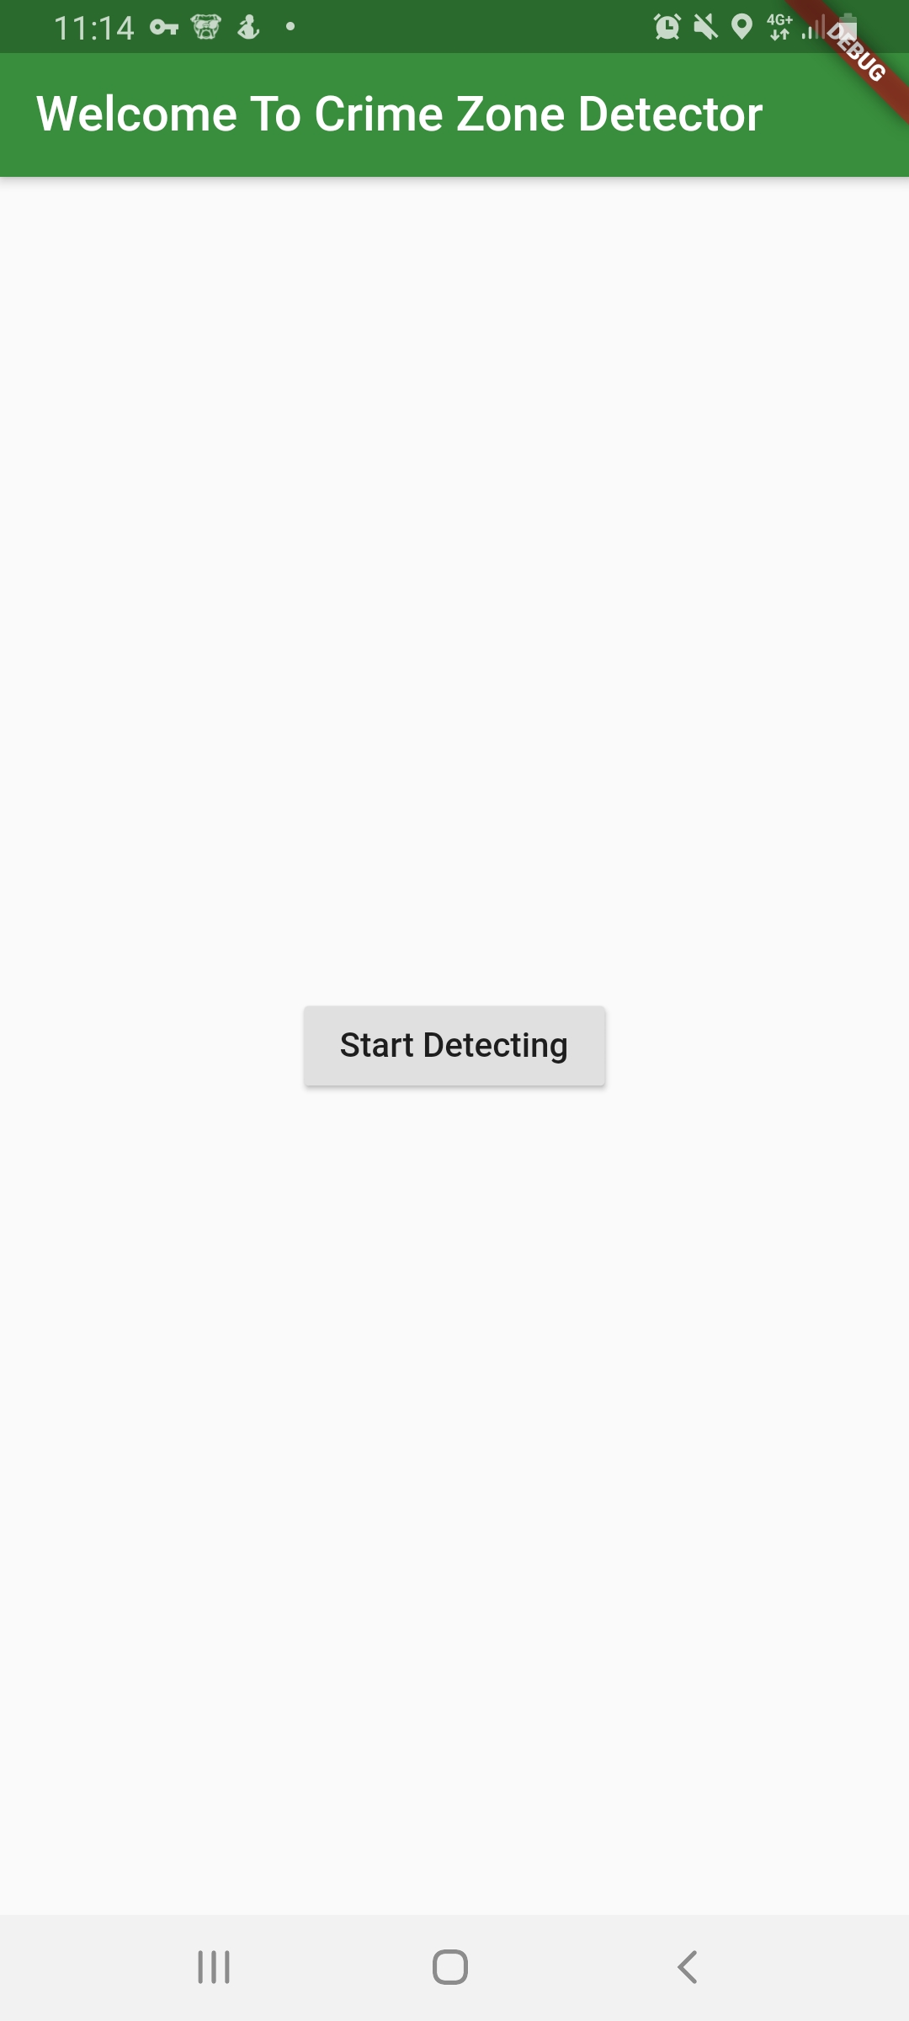
Results
The user signs in and after signing in, they are met with this interface and they can click the “Start Detecting” button

Slide 14
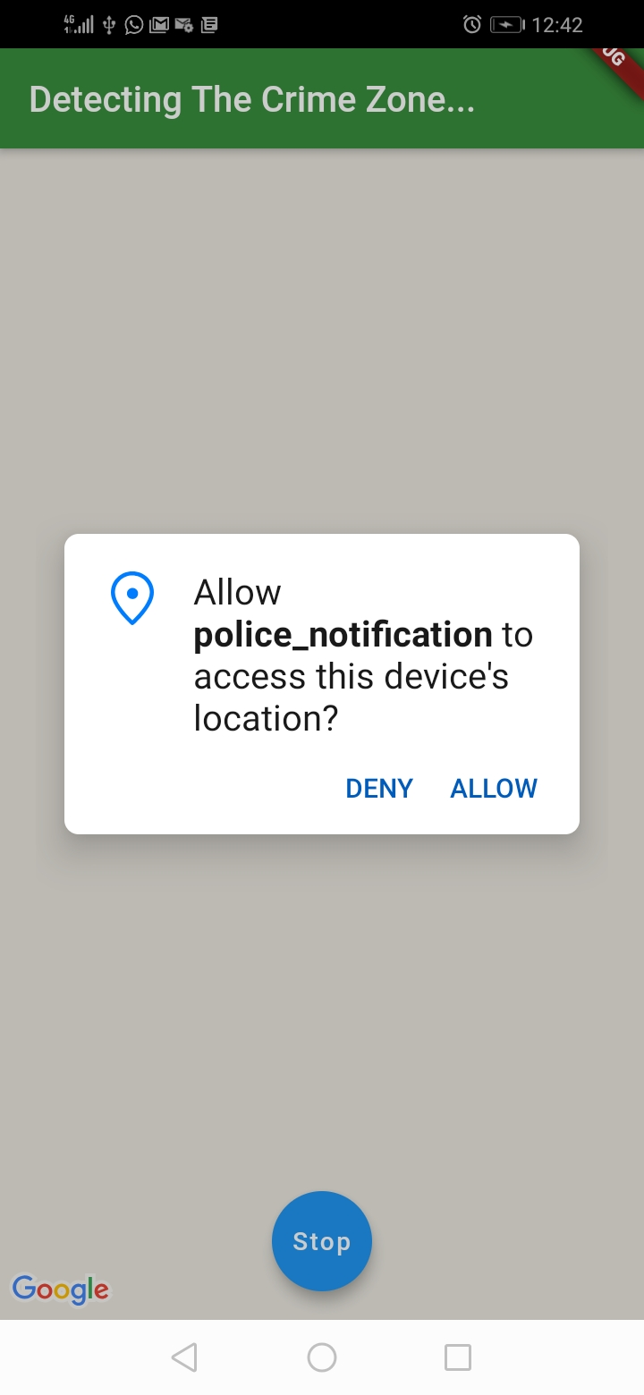
The user is prompted for permissions

Slide 15
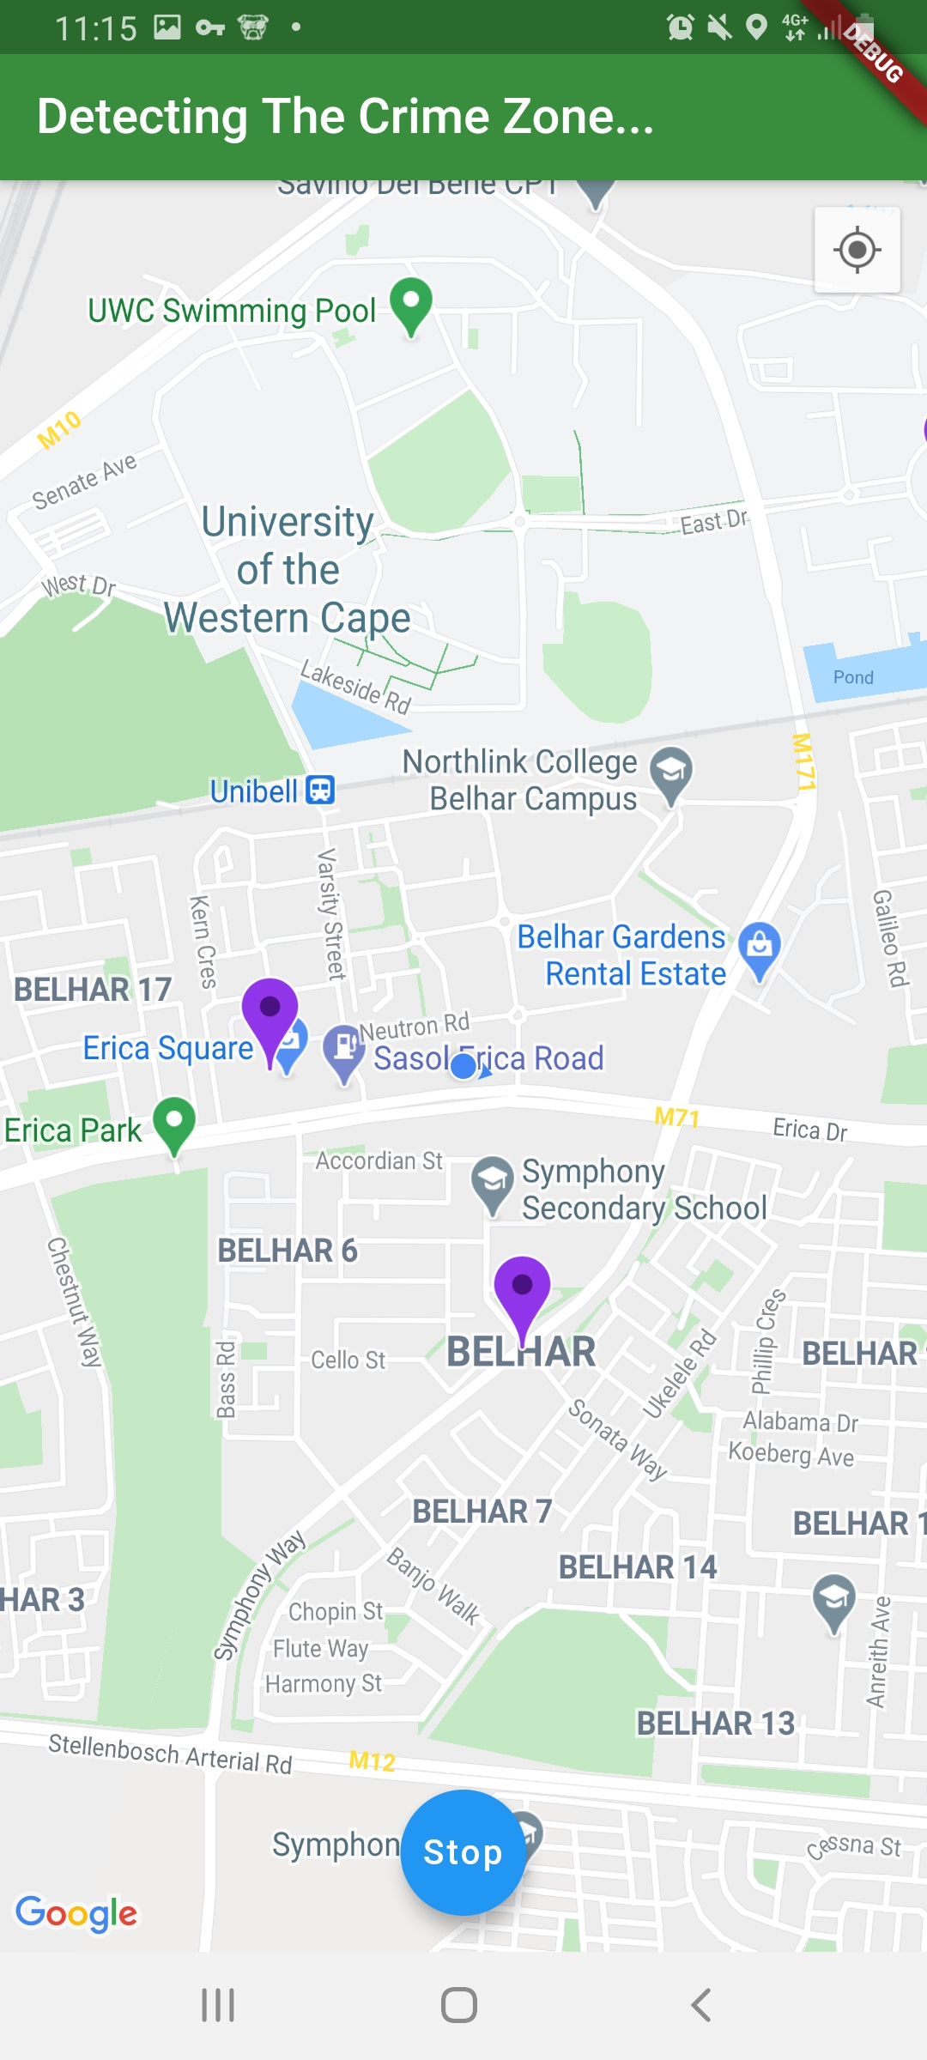
The purple markers show the danger zones on the map.

Slide 16
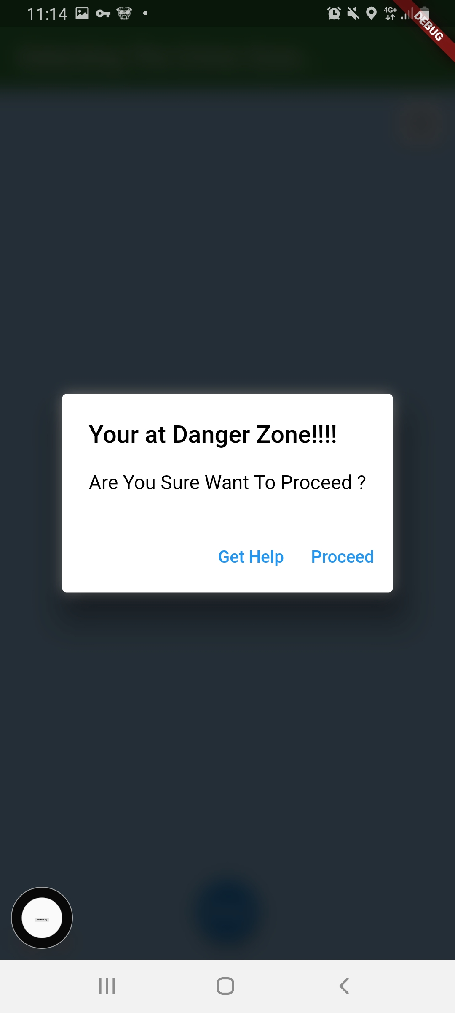
An alert pops up when you get to the danger zone, and in the case that you’re anticipating a crime/an attack you can either, get help or proceed. The Get Help button notifies a user with the same application(and the police) in case of an emergency.

Slide 17
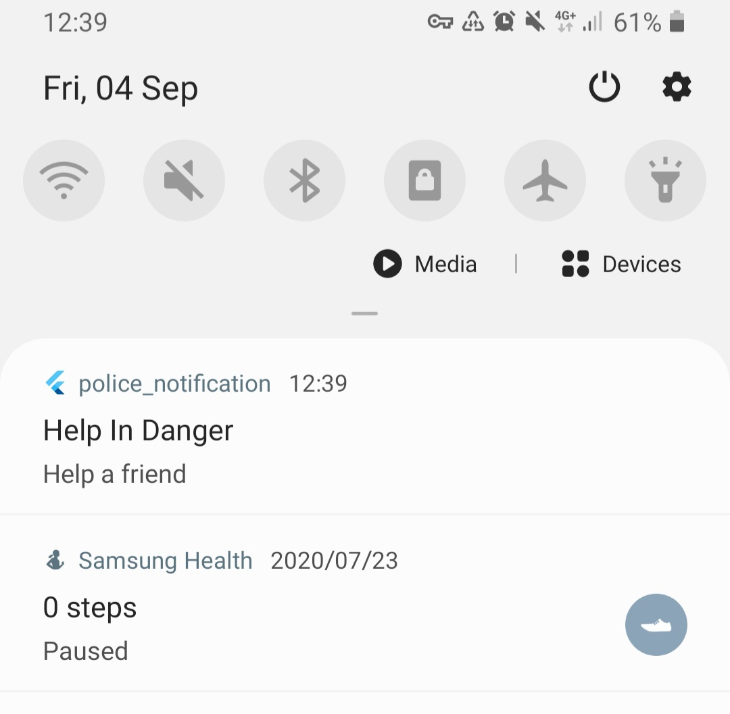
Message sent to other device if help is needed

Slide 18
Discussion
Future Improvements
Use machine learning to analyse crime data.
Classify the severity of crime in locations
Using Google Nearby API to reach nearby devices only.
Allow for the application to send a notification to another device without said device having to download the application.
Give a user alternative routes
Individual Experience
Difficulties faced, etc.

Slide 19
References
“Hijacking on the rise across South Africa says Tracker’s latest vehicle crime statistics - Lowvelder.” [Online]. Available: https://lowvelder.co.za/700687/hijacking-on-the-rise-across-south-africa-says-trackers-latest-vehicle-crime-statistics/. [Accessed: 24-Aug-2020].
B. Suri, S. Taneja, N. Sahni, A. Varshney, A. Sharma, and R. Vidhani, “Smart threat alert system using IoT,” Proceeding - IEEE Int. Conf. Comput. Commun. Autom. ICCCA 2017, vol. 2017-January, no. December 2019, pp. 1246–1251, 2017, doi: 10.1109/CCAA.2017.8230006.
“Apps That Blast Out Crime Alerts Don’t Have to Rattle You - The New York Times.” [Online]. Available: https://www.nytimes.com/2019/05/29/technology/personaltech/neighborhood-crime-apps.html. [Accessed: 04-Sep-2020].
S. P. Prakash, G. D. Sanjay, K. K. Ghanshyam, T. S. Manojkumar, P. A. S. Gaikwad, and G. N. S. College, “‘ Identification of Crime and Accidental Area using IoT ,’” pp. 987–989, 2019.

Slide 20
DEMO
Link: https://youtu.be/-1ZTfKwJYts

